Slide 1

DEPARTMENT OF COMPUTER SCIENCE & ENGINEERING
SCHOOL OF COMPUTING
10214CS501
COMMUNITY SERVICE PROJECT
WINTER SEMESTER(2024-2025)
REVIEW - I
CAREER COMPASS: CHARTING YOUR PATH TO SUCCESS
SUPERVISED BY
Faculty Name MS S HASHINI
M.E.,Assistant Professor
PRESENTED BY
1. UTUKURU SAI SANATH (VTU26583)(23UECS0904)
2. SYED JAFFAR HUSSAIN (VTU24674)(23UECS0889)
3. BANDARI CHARAN (VTU26852)(23UECS0673)

Slide 2
AGENDA
ABSTRACT
OBJECTIVE
INTRODUCTION ABOUT VILLAGE
SURVEY
SURVEY ANALYSIS
SOCIETY RELEVANT PROBLEM IDENTIFICATION
NOVEL IDEA GENERATION
PROTOTYPE/DEVELOPMENT OF NEW SOLUTION
PHOTOS ,VIDEO WITH AUTHENTICATED SIGNATURES.

Slide 3
ABSTRACT
Personalized Career Assessments:
Identify strengths, interests, and values.
Explore career paths aligned with aspirations.
Expert Guidance:
Access detailed job descriptions and educational resources.
Receive professional advice for career planning and decision-making.
Career Tools:
Build resumes, prepare for interviews, and search for jobs.
Gain the skills to stand out in the job market.
Mentorship and Networking:
Connect with mentors and industry experts.
Gain valuable insights and build professional relationships.

Slide 4
OBJECTIVES
Aim of the Project :-
To guide the students by showing the steps to reach their goals in education sectors.
Scope of the Project :-
To Identify the strength, weakness and interest on particular sector.
Explore learn about future trends and in demand skills.
Setting clear goals and breaking them into actionable steps.
Suggestions on skill development through social medias .(Like You tube, Google, etc)
Motivating to participate curricular activities.
Suggesting people’s to play games(like sudoku, chess , ......etc) to sharp their mind not to divot on other things.

Slide 5
INTRODUCTION ABOUT VILLAGE
Sullurpet, a vibrant town in Andhra Pradesh holds historical, cultural, and strategic significance . Sullurpet Municipality was established as a Grade-III Municipality on 21st January 2012, covering 17.68 sq. km. It is located 94 km from the district headquarters in SPSR Nellore District, Andhra Pradesh. The town serves as the gateway to the Satish Dhawan Space Center (SHAR), Sriharikota, 17 km away. The population was 45,782 as per the 2011 Census (22,062 males and 23,720 females). The current estimated population is approximately 48,500. Climate & RainfallSullurpet experiences a tropical climate, with winters from November to February and summers from March to June. Annual rainfall averages 84 mm, mostly between November and January.
Key Attractions:-
Satish Dhawan Space Center (SHAR): India’s primary spaceport for ISRO, located 17 km away.

Slide 6
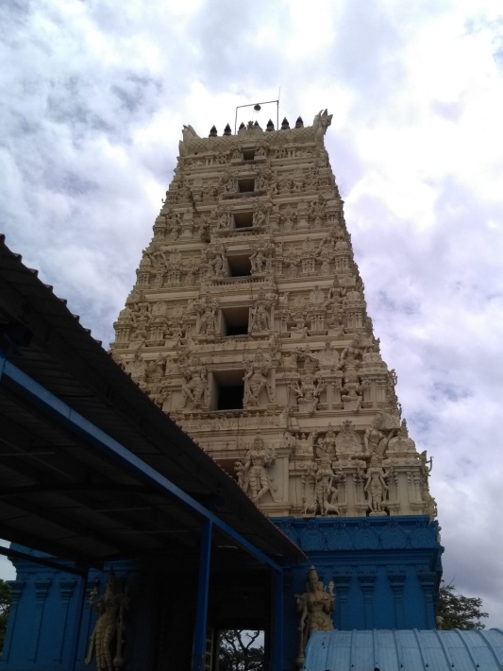
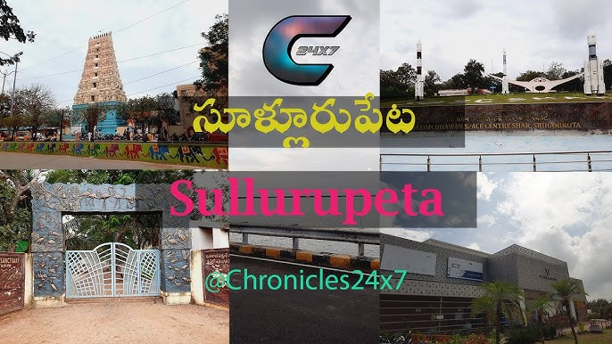
Pulicat Lake: India’s second-largest brackish water lagoon, renowned for its migratory bird species, including flamingos and pelicans.
Chengalamma Parameswari Temple: A 4th-5th century temple located on the Kalangi River, known for its “Tirunallu” and “Teppotsavam” festivals.
Mannar Swamy Temple: A 16th-century temple located in Mannarpoluru, Sullurpet, along the Kalangi River.
Hazrat Dawood Shah Wali Dargah: Asia’s tallest dargah, featuring a 144-foot-long mazar and attracting 20,000 pilgrims monthly.

Slide 7
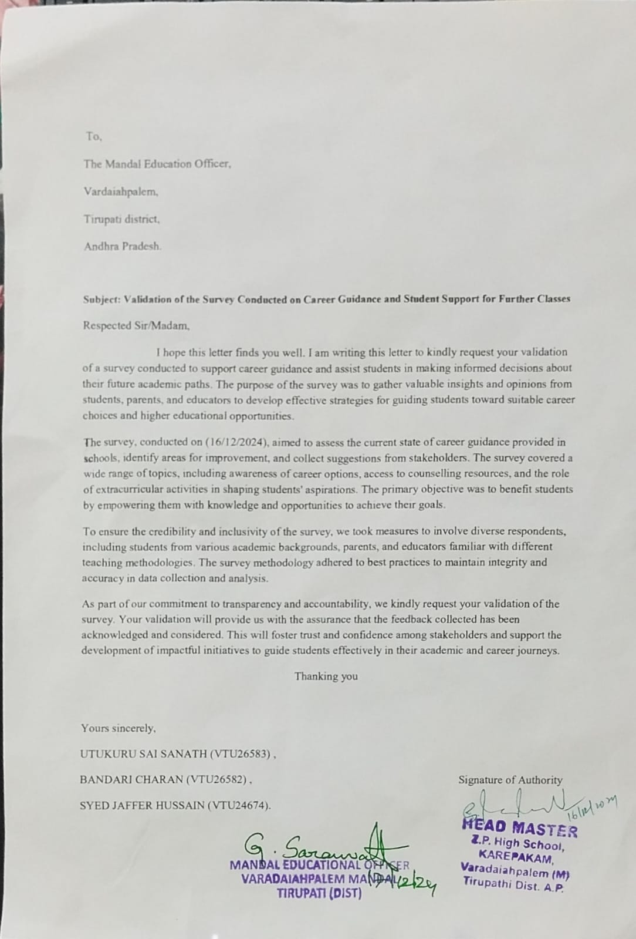
SURVEY-DETAILS

Slide 8
SURVEY ANALYSIS
As per the survey among 5 to 7 students are facing the same doubt or problem on education classification and what steps has to be taken next ?
The common questions asked by students are:
What is the main purpose of career guidance ?
What are the enterance exams their to get free education or getting to defence academy ?
What are the courses available in inter and also what are the education levels are their after inter ?
What are the details required for student login in career guidance website?

Slide 9
SURVEY ANALYSIS

Slide 10
SOCIETY RELEVANT PROBLEM IDENTIFICATION
Lack of Access: Not all students have access to quality career guidance services, especially those from low socio-economic backgrounds.
Information Gap: Students often lack accurate and up-to-date information about the latest introduced courses and career options.
Parental Influence: Parents may influence career choices without having the necessary knowledge, leading to poor career decisions.
Social Inequality: Career guidance can perpetuate social inequality if not accessible to all students equally.
Inadequate Training for Counselors: Career counselors may not be well- trained, affecting the quality of advice.
Peer Pressure: Students might make career choices based on peer pressure rather than their own interests and aptitudes.

Slide 11
PROTOTYPE/DEVELOPMENT OF NEW SOLUTION
Engaging Parents and Peers: Provide support materials for parents and create community forums where students can exchange their experiences.
Personalized Advice: AI tools to give customized career advice based on students' interests and skills.
Updated Info: Regularly updated information about careers, job trends, and education paths.
User-Friendly Design: A website and app that are simple for students to navigate and use effortlessly.
Modern Tech: Use of VR and AI chatbots for immersive career exploration and 24/7 support.

Slide 12
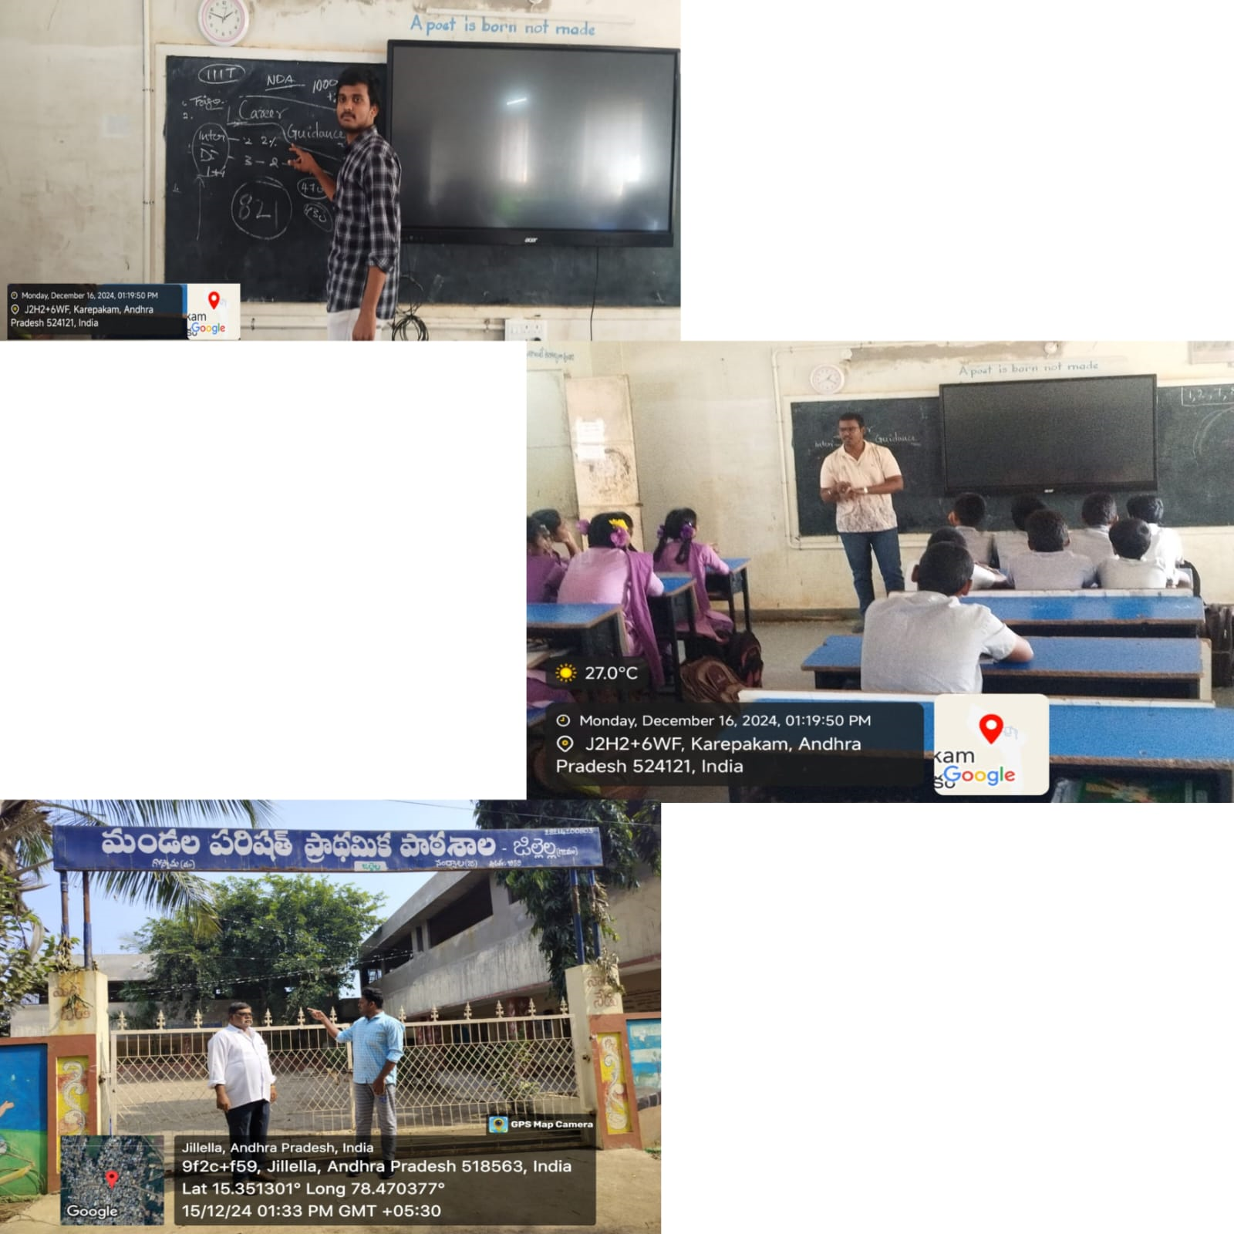
PHOTOS ,VIDEO WITH AUTHENTICATED SIGNATURES.

Slide 13
THANK YOU

